Slide 1





FinanceInsight
Named Entity Recognition (NER) Model for Financial Data Extraction
Internship Project Report | Infosys
Mentor Name : G Navinash
Intern Name : Abinash Das

Slide 2


Table of Contents
  Introduction
  Problem Statement
  Solution Overview
  Model Development
  System Architecture
  Tech Stack
  Impact & Performance
  Evaluation Metrics
  Future Scope
  Conclusion

Slide 3
Problem Statement:
The Data Overload in Financial Analysis
Financial analysts waste time manually extracting key metrics from unstructured reports because generic NLP fails to understand financial jargon and complex formats. This creates delays, errors, and unreliable insights in critical decision-making
  Critical financial decisions are being made on delayed or incomplete information, putting investments, risk assessments, and market responses at direct risk.
  Misinterpretation of financial jargon or metrics can lead to catastrophic analytical errors, especially when dealing with earnings, valuations, or regulatory filings.
  The current manual process leaves organizations vulnerable to missed red flags, compliance failures, and competitive disadvantages because they can’t extract insights at the speed the market demands.

Slide 4


Solution: FinanceInsight
Specialized Extraction Engine:
A domain-specific Financial NER system that automatically extracts accurate metrics, entities, and events from unstructured financial text at scale.
A fine-tuned FinBERT model identifies and extracts specific financial numerals that general models typically miss.
LLM powered Analysis:
An LLM powered by Google Gemini processes uploaded financial documents, converting messy, unstructured text into accurate, actionable insights on demand.
User Friendly UI:
A user-friendly interface that utilizes our technology pipeline to answer complex questions with strict citations from the source text.

Slide 5
Approach
  Data Sourcing: Leveraged the FiNER-139 dataset from Hugging Face containing 1.1 million annotated tokens extracted from real 10-K filings. to capture 139+ distinct financial entity types (e.g., Amortization, Revenue) instead of generic tags.
  Model Fine-Tuning: Trained FinBERT on financial domain text to achieve high-precision extraction of complex numeric data and jargon.
  LLM Pipeline: Built a pipeline with Gemini 2.5 Flash for semantic synthesis, context understanding to deliver precise answers with zero hallucinations.
  Unified System Integration: Integrated the NER and LLM into a modular Streamlit workflow, with an OCR fallback to make even scanned PDFs and images fully readable.

Slide 6


ARCHITECTURE DIAGRAM
Next Slide

Slide 7
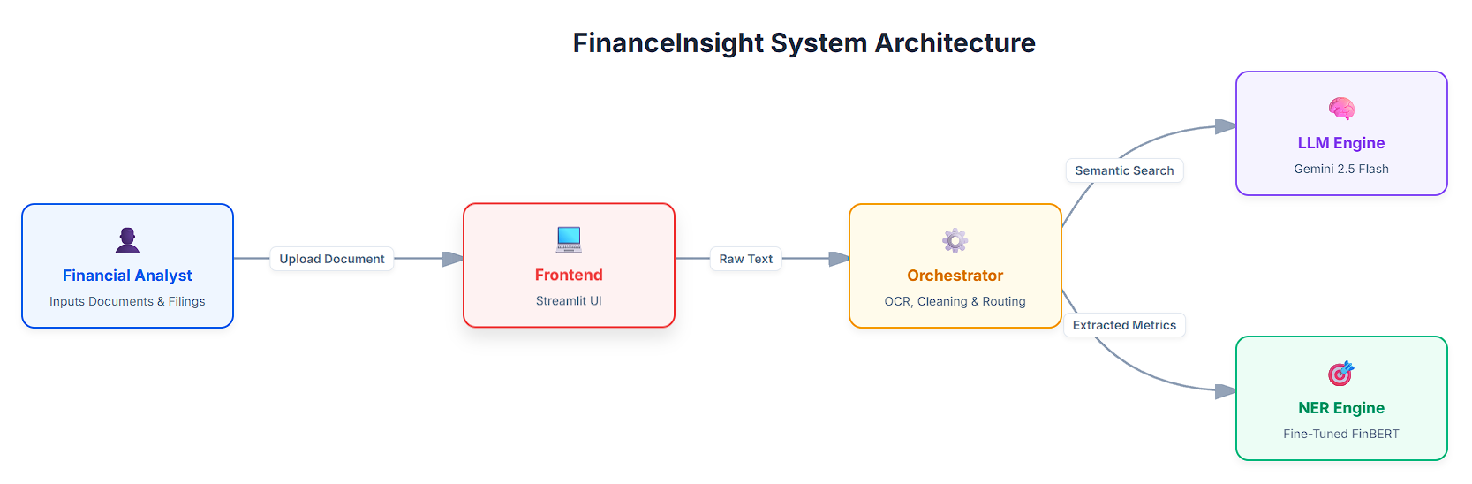

Slide 8
Tech Stack
Frontend & Interface
  Streamlit: Rapid deployment of the interactive web UI for document upload and entity extraction display.
Generative AI & Orchestration
  LangChain: Framework for managing prompt context and LLM orchestration.
  Google Gemini 2.5 Flash: High-speed LLM for semantic synthesis, context understanding and output formatting.
Extraction Intelligence (NER)
  FinBERT: Domain-specific BERT model fine-tuned for financial entity recognition on the FiNER-139 dataset.
  Hugging Face Transformers: Framework used for loading and inference with the fine-tuned FinBERT model.
Document Processing & OCR
  Built a unified pipeline that ingests PDFs, Word files, text documents, images, and CSVs—extracting text, parsing tables, and applying OCR to ensure every format becomes clean, machine-readable data.

Slide 9

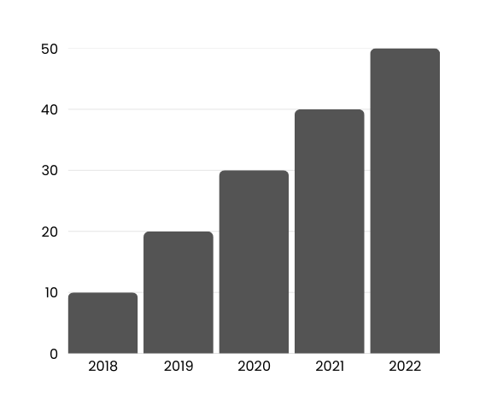

Impact & Analysis
  Operational Efficiency: Reduces document analysis time by 90%, processing complex filings in seconds.
  Precision Extraction: Fine-tuned FinBERT model achieves superior accuracy on 139+ specific financial entities compared to generic models.
  Strategic Value: Transforms unstructured filings into structured, audit-ready data, accelerating investment decisions and risk assessment.

Slide 10
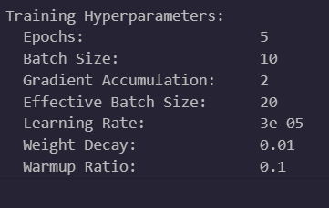
Evaluation
F1_score: 0.9722
Precision : 0.9748
Recall : 0.9696

Slide 11
Future Scope & Enhancements
  Semantic Search & RAG – Integrating a vector database for fast semantic retrieval and a RAG pipeline for natural-language, citation-backed answers.
  Autonomous Financial Agents – Building agentic systems that perform multi-step financial analysis, detect anomalies, and generate insights without manual prompts.
  Advanced Table Parsing – Creating algorithms to accurately extract and reconstruct complex financial tables that traditional OCR often misreads.
  Automated Event Detection – Extending the system to identify major corporate events like M&A, IPOs, and stock splits directly from textual data.

Slide 12

Conclusion
FinanceInsight revolutionizes the analysis of unstructured financial filings by harnessing the power of Google's Gemini LLM and a fine-tuned FinBERT model. This dual-engine architecture automates the extraction of specific financial metrics, slashing processing time by 90% while ensuring unparalleled accuracy. The outcome is a robust, hallucination-free solution that transforms dense reports into instant, audit-ready insights for investors and analysts.

Slide 13

Thank You
"An investment in knowledge pays the best interest." — Benjamin Franklin

